Slide 1


Misunderstanding

Slide 2
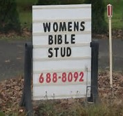
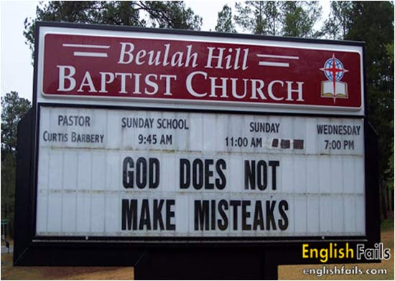
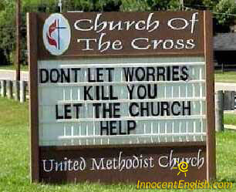
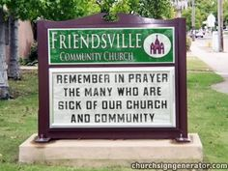

Misunderstanding

Slide 3
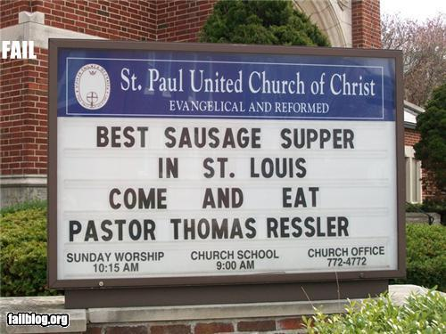
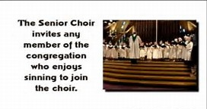
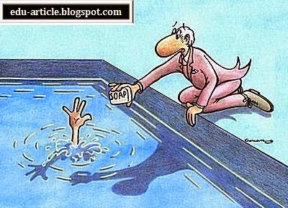
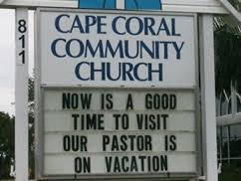
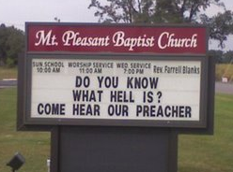
Misunderstanding

Slide 4

The Ten Most Misunderstood Words in the Bible

Slide 5

Saved? From What?

Slide 6
Saved? From What?
Failure to Observe Context
Results in adding unnecessary conditions for receiving eternal life.
“accompanying works to faith”

Slide 7
Saved? From What?
“…work out your own salvation with fear and trembling;” (Phil. 2:12b)
If this is talking about gaining eternal life, then we are required a lifetime of effort, during which we are concerned with not making it.

Slide 8
Saved? From What?
“For I know that this shall turn to my salvation through your prayer, and the supply of the Spirit of Jesus Christ,” (Phil. 1:19) [KJV]
Paul’s salvation was dependent on the prayers of others.

Slide 9
Saved? From What?
“Whoever walks blamelessly will be saved;…” (Proverbs 28:18)
The condition for this salvation is living flawlessly.

Slide 10
Saved? From What?
“Nevertheless she will be saved in childbearing if they continue in faith, love, and holiness, with self-control.” (1 Tim. 2:15)
Her salvation is dependent on her children persevering in good behavior.

Slide 11
Saved? From What?
“Take heed to yourself and to the doctrine. Continue in them, for in doing this you will save both yourself and those who hear you.” (1 Tim. 4:16)
Salvation is dependent on continuing in good teaching and good behavior.

Slide 12
Saved? From What?
“You will save the humble people;…” (2 Sam 22:28) and “…He will save the humble person.” (Job 22:29)
Salvation is conditioned on humility of a person, not faith in Christ.

Slide 13
Saved? From What?
“And having been perfected, He became the author of eternal salvation to all who obey Him,” (Hebrews 5:9)
Salvation requires obedience even in the presence of suffering and persecution.

Slide 14
Saved? From What?
“For with the heart one believes unto righteousness, and with the mouth confession is made unto salvation.” (Romans 10:10)
Believing is not enough for salvation, public confession is also necessary.

Slide 15
Saved? From What?
“Whoever calls on the name of the LORD shall be saved.” (Romans 10:13, Joel 2:32)
Calling on Him must be added to believing in order to be born again.

Slide 16
Saved? From What?
“What does it profit, my brethren, if someone says he has faith but does not have works? Can faith save him?” “…You see then that a man is justified by works, and not by faith only.” (James 2:14,24)

Slide 17
Saved? From What?
Failure to Observe Context
Results in adding unnecessary conditions for receiving eternal life.
Faith accompanied by good works, obedience, perseverance, prayer, confession before men, and humility.

Slide 18
Saved? From What?
Failure to Observe Context
Results in a failure to understand that we may need to call on the name of the LORD to be saved from troubles and afflictions that are sure to arise in the believers life.

Slide 19
Saved? From What?
“sozo” (109x’s) – verb
“saved” “delivered”, “protected”, “to heal”, “to make whole”.

Slide 20
Saved? From What?
“soteria” (46x’s) – noun
“salvation” “deliver”, “rescue”,
“health”, “safety”.

Slide 21
Saved? From What?
In the Old Testament
There is not a single use of the words, “save”, “saved” or “salvation” in the OT that refers specifically to deliverance from hell and the gaining of eternal life.

Slide 22
Saved? From What?
In the New Testament
Only three out of ten (30%) uses of “salvation” and “save” refer to salvation from eternal condemnation and to obtaining eternal life.

Slide 23
Saved? From What?
In the New Testament
This means that seven out of ten (70%) uses of “salvation” and “save” does not mean what people think it means, leading to a wide misunderstanding and confusion.

Slide 24
Old Testament Salvation
Deliverance from Enemies
“Give them [the wicked] according to their deeds, and according to the wickedness of their endeavors; Give them according to the work of their hands; Render to them what they deserve.” (Ps. 28:3-4)

Slide 25
Old Testament Salvation
Deliverance from Enemies
“The LORD is their strength, and He is the saving refuge of His anointed. Save Your people, and bless Your inheritance; Shepherd them also, and bear them up forever.” (Ps. 28:8-9)

Slide 26
Old Testament Salvation
Deliverance from Enemies
“The LORD is my rock and my fortress and my deliverer;… I will call upon the LORD, who is worthy to be praised; so shall I be saved from my enemies.” (Psalm 18:2-3)

Slide 27
Old Testament Salvation
Deliverance from Enemies
“I will sing a new song to You, O God; On a harp of ten strings I will sing praises to You, the One who gives salvation to kings, Who delivers David His servant from the deadly sword.” (Psalm 144:10)

Slide 28
Old Testament Salvation
Deliverance from Enemies
“O GOD the Lord, the strength of my salvation, You have covered my head in the day of battle.” (Psalm 140:7)

Slide 29
Old Testament Salvation
Deliverance from Enemies
“Oh, let the wickedness of the wicked come to an end, but establish the just;… My defense is of God, Who saves the upright in heart.” (Psalm 7:9-10)

Slide 30
Old Testament Salvation
Deliverance from Trouble
“Now consider this, you who forget God, lest I tear you in pieces, and there be none to deliver: Whoever offers praise glorifies Me; And to him who orders his conduct aright I will show the salvation of God.” (Ps. 50:22-23)

Slide 31
Old Testament Salvation
Deliverance from Trouble
“Call upon Me in the day of trouble;
I will deliver you, and you shall glorify Me.” (Ps. 50:15)

Slide 32
Old Testament Salvation
Deliverance from Trouble
“He shall call upon Me, and I will answer him; I will be with him in trouble; I will deliver him and honor him. With long life I will satisfy him, and show him My salvation.” (Ps. 91:15-16)

Slide 33
Old Testament Salvation
Deliverance from Trouble
“May the LORD answer you in the day of trouble;… May He grant you according to your heart's desire, and fulfill all your purpose. We will rejoice in your salvation,…” (Ps. 20:1-5)

Slide 34
Old Testament Salvation
Deliverance of the Poor and Needy
from their Afflictions
“For the oppression of the poor, for the sighing of the needy, now I will arise,’ says the LORD; ‘I will set him in the safety for which he yearns.” (Ps. 12:5)

Slide 35
Old Testament Salvation
Deliverance of the Poor and Needy
from their Afflictions
David said, “But I am poor and needy; Yet the LORD thinks upon me. You are my help and my deliverer; Do not delay, O my God.” (Ps. 40:17)

Slide 36
Old Testament Salvation
Deliverance of Israel from Captivity
“Oh, that the salvation of Israel would come out of Zion! When the LORD brings back the captivity of His people, let Jacob rejoice and Israel be glad.” (Ps. 14:7)

Slide 37
Old Testament Salvation
No References to Salvation from Eternal Condemnation
The OT discusses justification and regeneration but it never calls that salvation. “Saved” and “Salvation” are never used in the OT to refer to salvation from eternal condemnation.

Slide 38
Old Testament Salvation
Salvation Exceptions
“Restore to me the joy of Your salvation,…” (Ps. 51:12)
David is remembering times when the LORD saved him from his troubles in the past. He wants that joy.

Slide 39
Old Testament Salvation
Salvation Exceptions
“Rejoice greatly, O daughter of Zion! Shout, O daughter of Jerusalem! Behold, your King is coming to you; He is just and having salvation, lowly and riding on a donkey” (Zech. 9:9)

Slide 40
Old Testament Salvation
Salvation Exceptions
This seems to be reference to salvation from eternal condemnation, but it is more likely a reference to Israel’s salvation from all the Gentile nations that threaten and oppress her.

Slide 41
Salvation Old and New
Note: Salvation from eternal condemnation is and has always been by “faith alone in Christ alone” the means of receiving eternal life, both in the OT and the NT.

Slide 42
Salvation Old and New
Note: An atonement for sin (substitutionary blood sacrifice) is and has always been the basis by which God makes the gift of eternal life available.

Slide 43
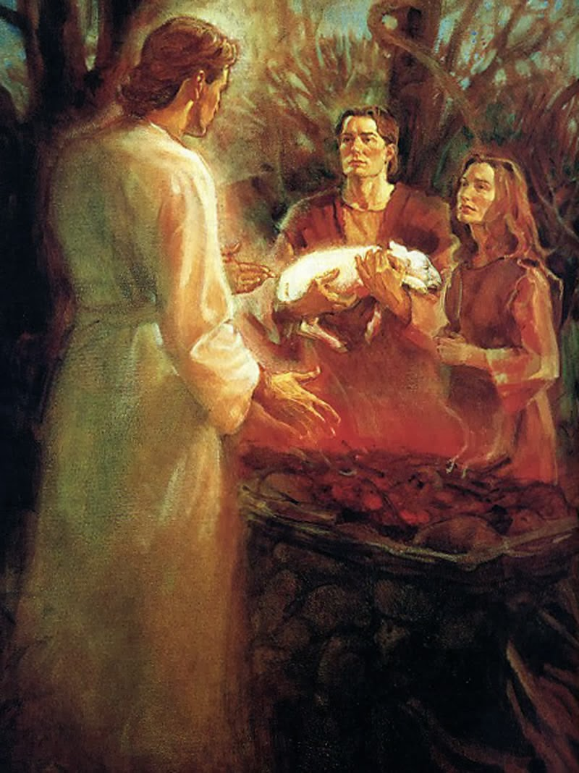
Old Testament Salvation
Note: The way to God was through a sacrifice, that He supplied.

Slide 44
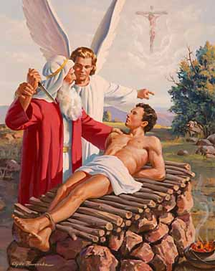
Old Testament Salvation
Note: The way to God was through a sacrifice, that He supplied.

Slide 45
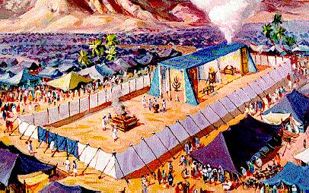
Old Testament Salvation

Slide 46
Old Testament Salvation
So, as time past God progressively gave additional content concerning sin and salvation, until it was codified in the Mosaic Law. The Law showed that man was a sinner and salvation was through a sacrifice something greater than the blood of animals.

Slide 47
Old Testament Salvation
They knew that without the shedding of blood there is no remission of sin (Heb. 9:22) and that it is not possible that the blood of bulls and goats (finite creatures) could take away sins.” (Heb. 10:4)

Slide 48
Old Testament Salvation
“And every priest stands ministering daily and offering repeatedly the same sacrifices, which can never take away sins. But this Man, after He had offered one sacrifice for sins forever, sat down at the right hand of God,” (Heb. 10:11-12)

Slide 49
Old Testament Salvation
“For I desire mercy, not sacrifice, and acknowledgment of God rather than burnt offerings.” (Hos 6:6)

Slide 50
Old Testament Salvation
“Take words with you, and return to the LORD [believe in Me]. I will then, ‘Take away all iniquity; receive it graciously, then you will offer the sacrifices of your lips.” (Hos 14:2)

Slide 51

New Testament Salvation
“Most of the New Testament uses of “saved” and “salvation” do not refer to deliverance from eternal condemnation.

Slide 52
New Testament Salvation
Deliverance from Death or Illness
“And suddenly a great tempest arose on the sea, so that the boat was covered with the waves. But He was asleep. Then His disciples came to Him and awoke Him, saying, ‘Lord, save us! We are perishing!” (Matt. 8:24-25)

Slide 53
New Testament Salvation
Deliverance from Death or Illness
“…But when he saw that the wind was boisterous, he was afraid; and beginning to sink he cried out, saying, "Lord, save me!” (Matt. 14:30)

Slide 54
New Testament Salvation
Deliverance from Death or Illness
“And the soldiers' plan was to kill the prisoners, lest any of them should swim away and escape. But the centurion, wanting to save Paul, kept them from their purpose,…” (Acts 27:42-43)

Slide 55
New Testament Salvation
Deliverance from Death or Illness
All five verses in James refers to being saved from an early death (James 1:21; 2:14; 4:12; 5:15, 20).
Faith without works can not save you from physical death, it profits you nothing.

Slide 56
New Testament Salvation
Deliverance from God’s Wrath
Salvation in Romans is deliverance from God’s wrath here and now, not from eternal condemnation.
Salvation for believers,
not unbelievers

Slide 57
New Testament Salvation
Deliverance from God’s Wrath
“Saved” used 5x’s,
“Salvation” used just 8x’s
All of them refer to deliverance from God’s temporary punishment.

Slide 58
New Testament Salvation
Deliverance from God’s Wrath
“Saved” used 5x’s,
“Salvation” used just 8x’s
“Saved” or , “Salvation”
is not used in the section (2-4) on “justification by faith alone”

Slide 59
New Testament Salvation
Deliverance from God’s Wrath
Believers are saved by calling on the name of the LORD to be delivered from temporal wrath (10:13, Joel 2:32).
Context: The Day of the LORD

Slide 60
New Testament Salvation
Deliverance from God’s Wrath
Israel will be saved when they cry out to the LORD Jesus, in whom they have already believed, to save them from annihilation by the Gentiles armies.

Slide 61
New Testament Salvation
Deliverance from God’s Wrath
“Much more then, having now been justified by His blood, we shall be saved from wrath through Him… having been reconciled, we shall be saved by His life.” (Rom 5:9-10)

Slide 62
New Testament Salvation
Deliverance from God’s Wrath
“Paul’s point is that we shall be saved from God’s wrath in this life by means of the resurrection power of Jesus living through us.”
(Bob Wilkin, p. 42)

Slide 63
New Testament Salvation
Deliverance from God’s Wrath
“For if you live according to the flesh you will die; but if you walk by the Spirit… you will live” (Romans 8:13)

Slide 64
New Testament Salvation
Deliverance from God’s Wrath
By living by the means of the Spirit we can be delivered from God’s wrath, which is the manifestation of His temporal displeasure of sin, so vividly described in Romans 1:18-32.

Slide 65
New Testament Salvation
Deliverance from God’s Wrath
The Gospel (1:16) that Paul preached is the vehicle for the power of God by which men can be delivered from His own temporal wrath.

Slide 66
New Testament Salvation
Deliverance from the Coming Tribulation Wrath
“…wait for His Son from heaven, whom He raised from the dead, even Jesus who delivers us from the wrath to come.” (1 Thess. 1:10)

Slide 67
New Testament Salvation
Deliverance from the Coming Tribulation Wrath
“For God did not appoint us to wrath, but to obtain salvation, [via the Rapture], through our Lord Jesus Christ,...” (1 Thess. 5:9)

Slide 68
New Testament Salvation
Successfully Handling Persecution in a God-Honoring Way
“For I know that this will turn out for my deliverance through your prayer and the supply of the Spirit of Jesus Christ,” (Phil 1:19). Why? So that he might glorify Christ in his affliction.

Slide 69
New Testament Salvation
Successfully Handling Persecution in a God-Honoring Way
“work out your own salvation with fear and trembling;” (Phil 2:12).
They needed to work out their own successful handling of persecution.

Slide 70
New Testament Salvation
Successfully Handling Persecution in a God-Honoring Way
“that you may become blameless and harmless, children of God…” (2:15).
“…so that I may rejoice in the day of Christ…” (2:16)

Slide 71
New Testament Salvation
Becoming Christ’s Partners in the Life to Come (Hebrews)
“And having been perfected, He became the author of eternal salvation to all who obey Him,” (Heb. 5:9)

Slide 72
New Testament Salvation
Becoming Christ’s Partners in the Life to Come (Hebrews)
In Hebrews the eternal salvation is the eternal partnership with Christ, that requires we obey Him by enduring persecution for Him.

Slide 73
New Testament Salvation
Deliverance from False Teachers and False Teaching
“Take heed to yourself and to the doctrine. Continue in them, for in doing this you will save both yourself and those who hear you.” (1 Tim 4:16)

Slide 74
New Testament Salvation
Deliverance from False Teachers and False Teaching
“Nevertheless she will be saved in childbearing if they continue in faith, love, and holiness, with self-control. (1 Tim 2:15)

Slide 75
New Testament Salvation
Deliverance from False Teachers and False Teaching
All the uses of salvation in First Timothy refers to fullness of life here and now, a life well lived, a life to be proud of.

Slide 76
New Testament Salvation
Deliverance from
Eternal Condemnation
“For God did not send His Son into the world to condemn the world, but that the world through Him might be saved.” (John 3:17)

Slide 77
New Testament Salvation
Deliverance from
Eternal Condemnation
“even when we were dead in trespasses, made us alive together with Christ (by grace you have been saved).” (Eph. 2:5)

Slide 78
New Testament Salvation
Deliverance from
Eternal Condemnation
“For by grace you have been saved through faith and that not of yourselves; it is the gift of God,…” (2:8) – refers to the new birth.

Slide 79
New Testament Salvation
Deliverance from
Eternal Condemnation
“…but according to His mercy He saved us, through the washing of regeneration and renewing of the Holy Spirit,” (Titus 3:5)

Slide 80
New Testament Salvation
Deliverance from
Eternal Condemnation
“…but according to His mercy He saved us, through the washing of regeneration and renewing of the Holy Spirit,” (Titus 3:5)

Slide 81
Conclusion

Slide 82
Saved? From What?
Saved from the Penalty of Sin
Eternal Condemnation
Saved from the Power of Sin
Temporal Consequences
Saved from the Presence of Sin
Eternal Company

Slide 83
Saved? From What?
Are you “saved”
from eternal condemnation?
Jesus said, “he who believes in Him will not perish but has everlasting life… and is not condemned” (John 3:16, 18)

Slide 84
Saved? From What?
Are you “saved”
from temporal circumstances?
“whoever calls on the name of the LORD shall be saved.” (Romans 10:13)

Slide 85
Saved? From What?
Are you “saved”
from Eternal Company
“…the resurrection of the dead. The body is sown in corruption, it is raised in incorruption…” (1 Cor. 15:42)

